Slide 1
StudyMate: Your AI-Powered Study Companion
Revolutionizing how students interact with their academic materials.

Slide 2

What is StudyMate?
StudyMate is an AI-powered academic assistant designed to transform passive reading into active learning. It allows students to engage with their study materials through a conversational Q&A format.

Slide 3
Key Problem Solved
Instead of passively reading large PDF documents or relying on manual searches for specific information, users can simply upload one or more PDFs and ask natural-language questions.
StudyMate responds with direct, well-contextualized answers, referenced from the source content, streamlining the study process.

Slide 4






Core Functionality: Conversational Q&A
Ask Anything
Contextual Answers
Source Referenced
Pose natural-language questions about your uploaded PDFs.
Receive answers directly from your study materials.
Answers are grounded in the original content for accuracy.

Slide 5
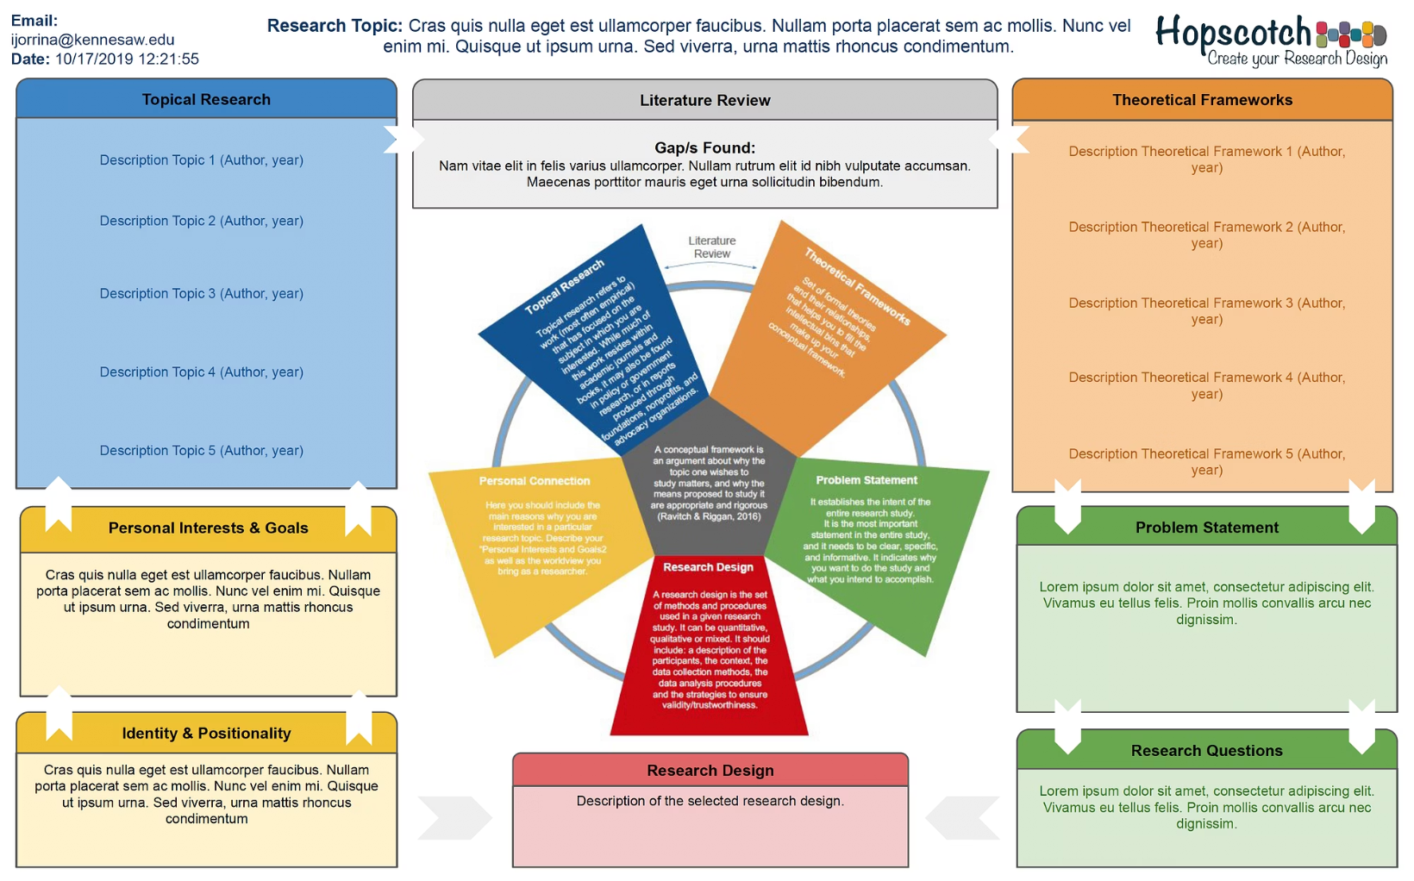
Accurate Text Extraction & Preprocessing
StudyMate efficiently extracts and chunks content from multiple PDFs using PyMuPDF. This ensures high-quality data for subsequent processing steps.

Slide 6



Semantic Search for Precise Matching
SentenceTransformers
FAISS Integration
Accurate Question Matching
Used to create embeddings for relevant text chunks.
Enables rapid and precise retrieval of the most relevant content.
Ensures answers are highly relevant to your queries.

Slide 7

LLM-Based Answer Generation
StudyMate leverages IBM Watsonx’s Mixtral-8x7B-Instruct model to generate informative and grounded answers from the retrieved content, ensuring high-quality responses.

Slide 8
User-Friendly Local Interface
1
2
3
Seamless Document Upload
Intuitive Question Input
Clear Result Visualization
Simple interface for asking questions.
Understand answers at a glance.
Easily add your study materials.
The Streamlit-based frontend provides a smooth and efficient user experience.

Slide 9




Technologies & Tools
Python
Streamlit
IBM Watsonx
HuggingFace
PyMuPDF
Mistral
FAISS

Slide 10

Study Smarter, Not Harder
StudyMate empowers students to engage with their materials more effectively, saving time and improving comprehension.

